Slide 1
Quickwrite
What is the difference between direct and indirect?
What is an example of something that is “direct”?
What is an example of something that is “indirect”?
Partner Share!

Slide 2
Characterization

Slide 3
Definition

Slide 4
Types
There are two types of characterization
Direct
Indirect

Slide 5
Direct Characterization
direct characterization: the author or narrator directly TELLS about a character’s traits. The author tells us about the character’s personality to our face.
TELLING

Slide 6
Example
“The patient boy and quiet girl were both well mannered and did not disobey their mother.”
Explanation: The author is directly telling the audience the personality of these two children. The boy is “patient” and the girl is “quiet.”

Slide 7
Indirect Characterization
Indirect characterization: the author or narrator reveals a character’s traits through his or her actions and speech.
SHOWING

Slide 8
Example
When Jane walked in the room, nobody could help but look at her stunning, gorgeous face. She commanded attention wherever she went due to her good looks.
Jane is beautiful.
Jim was very unlike any other businessman. He made sure that all his clients got what they had paid for.
Jim is honest and hardworking.

Slide 9
STEAL Method
Speech
Thoughts
Effect on others
Actions
Looks

Slide 10
Difference
Remember, the difference between direct and indirect characterization is TELLING V. SHOWING!
Indirect is like clues about the characters.
There in no mystery with direct because the author tells us what we need to know!

Slide 11
Freewrite
Provide both a direct and indirect characterization of yourself based on the story of your life. Each should be 3-4 sentences. Write one sentence explaining why your responses are direct or indirect.

Slide 12
Indirect or Direct Characterization?
http://www.youtube.com/watch?v=zvQjbrJquFs&safe=active
http://www.youtube.com/watch?v=mWBWnJMHEs8&safe=active

Slide 13
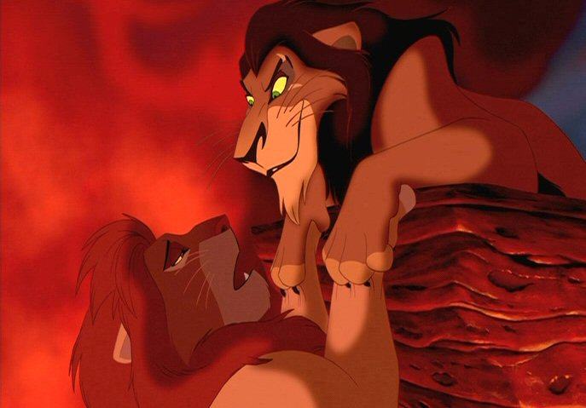
What about this scene?

