Slide 1
Non-fiction text features
Copy definitions under the flaps

Slide 2
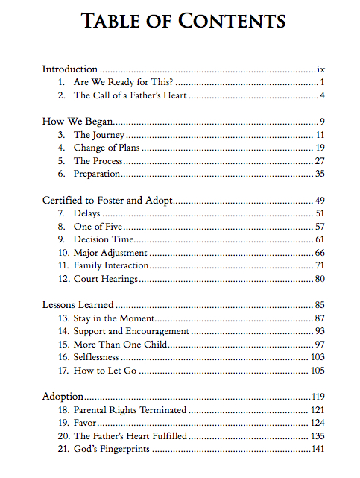
table of contents
Identify key topics in the book and the order they are presented in
Front of the book

Slide 3
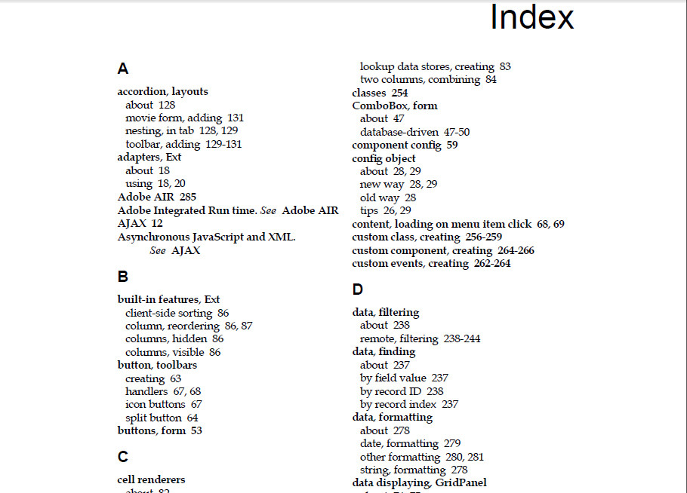
Index
See every concept in the text listed alphabetically, with page numbers.
Back of the book
This Photo by Unknown Author is licensed under CC BY-SA

Slide 4
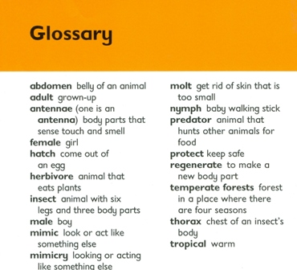
glossary
This Photo by Unknown Author is licensed under CC BY-NC-ND
Definitions for words contained in the text

Slide 5
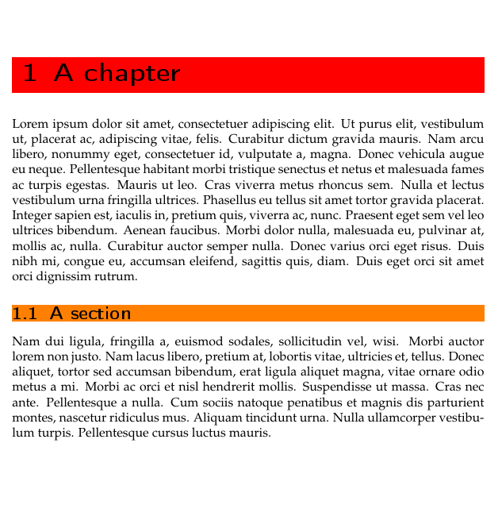
headings
Identify topics throughout the book as a reader skims or scans text

Slide 6
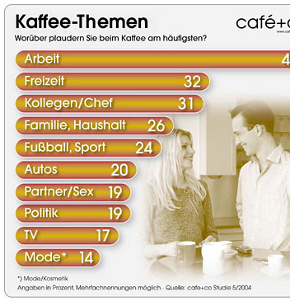
subheadings
Subdivision of heading that normally gives more specific information

Slide 7
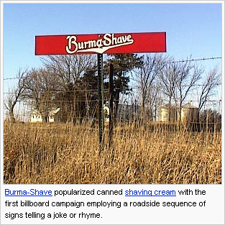
photograph
Taken with a camera
Shows what something looks like

Slide 8
captions
Text that explains what is happening in a photo, illustration, etc.

Slide 9
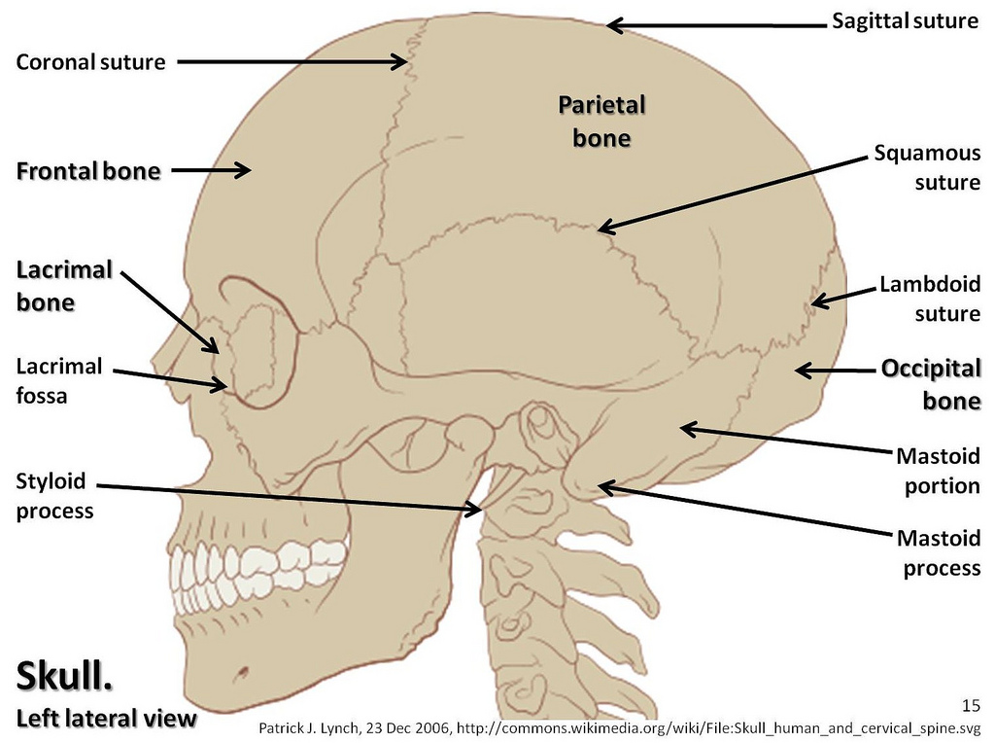
labels
Identify the parts in an illustration, photo, map, etc.

Slide 10
diagrams
A more detailed or simple view of information

Slide 11
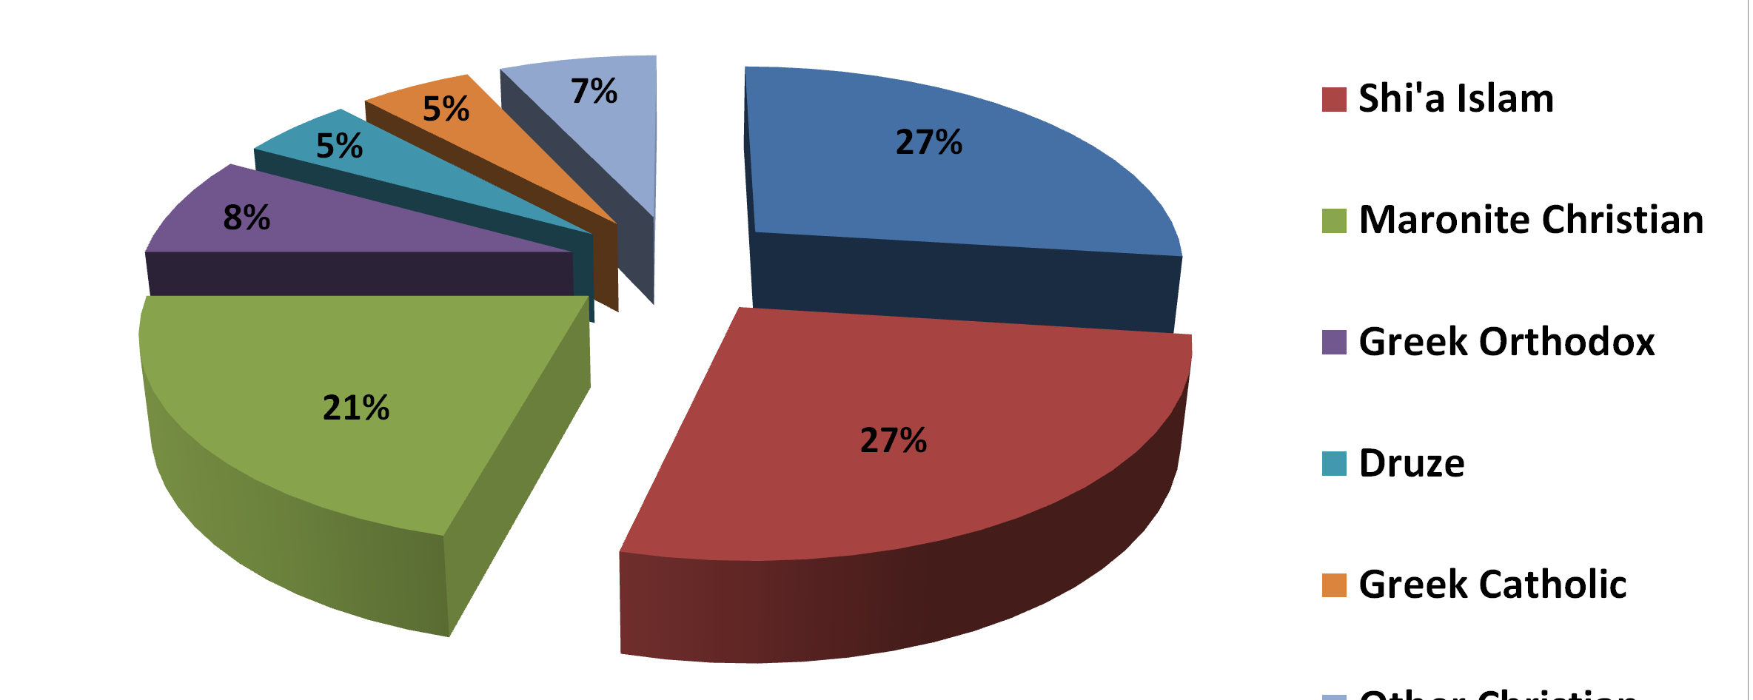
graphs
Organizes and helps compare information in a visual way

Slide 12
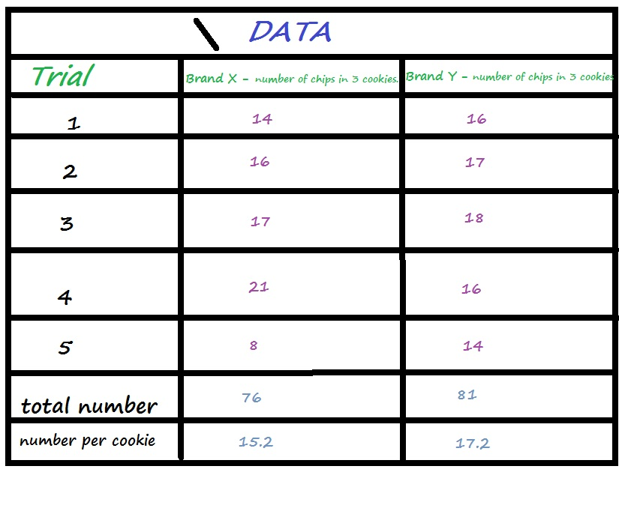
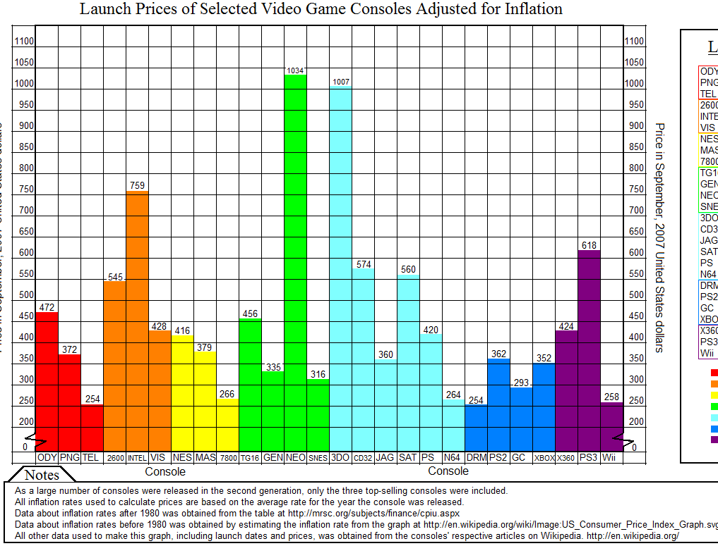
charts
Organizes facts and numbers in a visual way so it is easier to read (also called table)

Slide 13
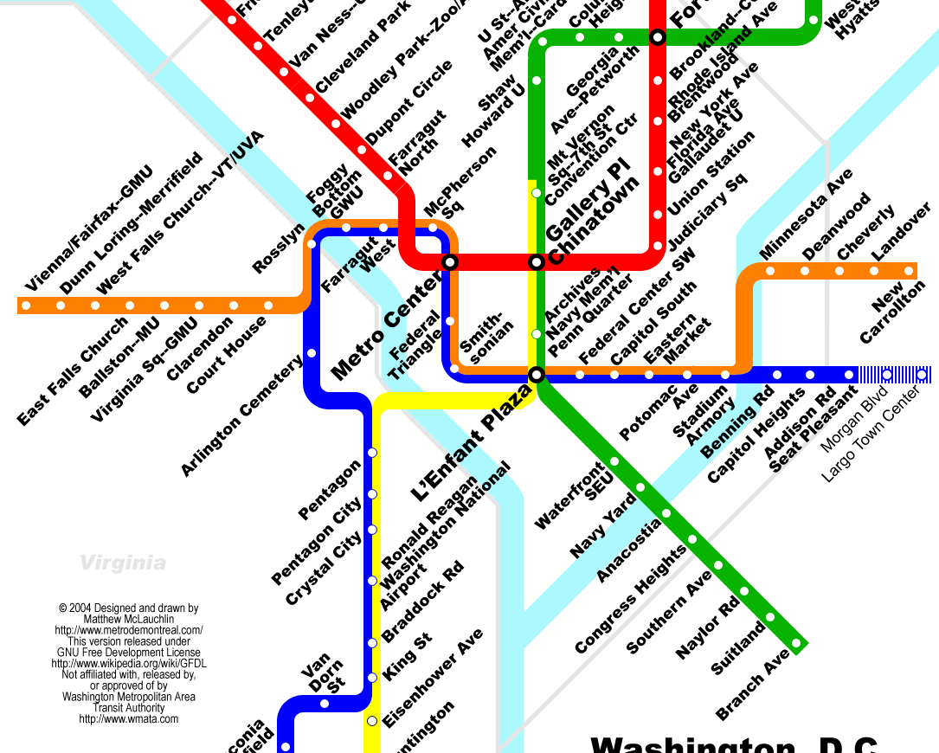
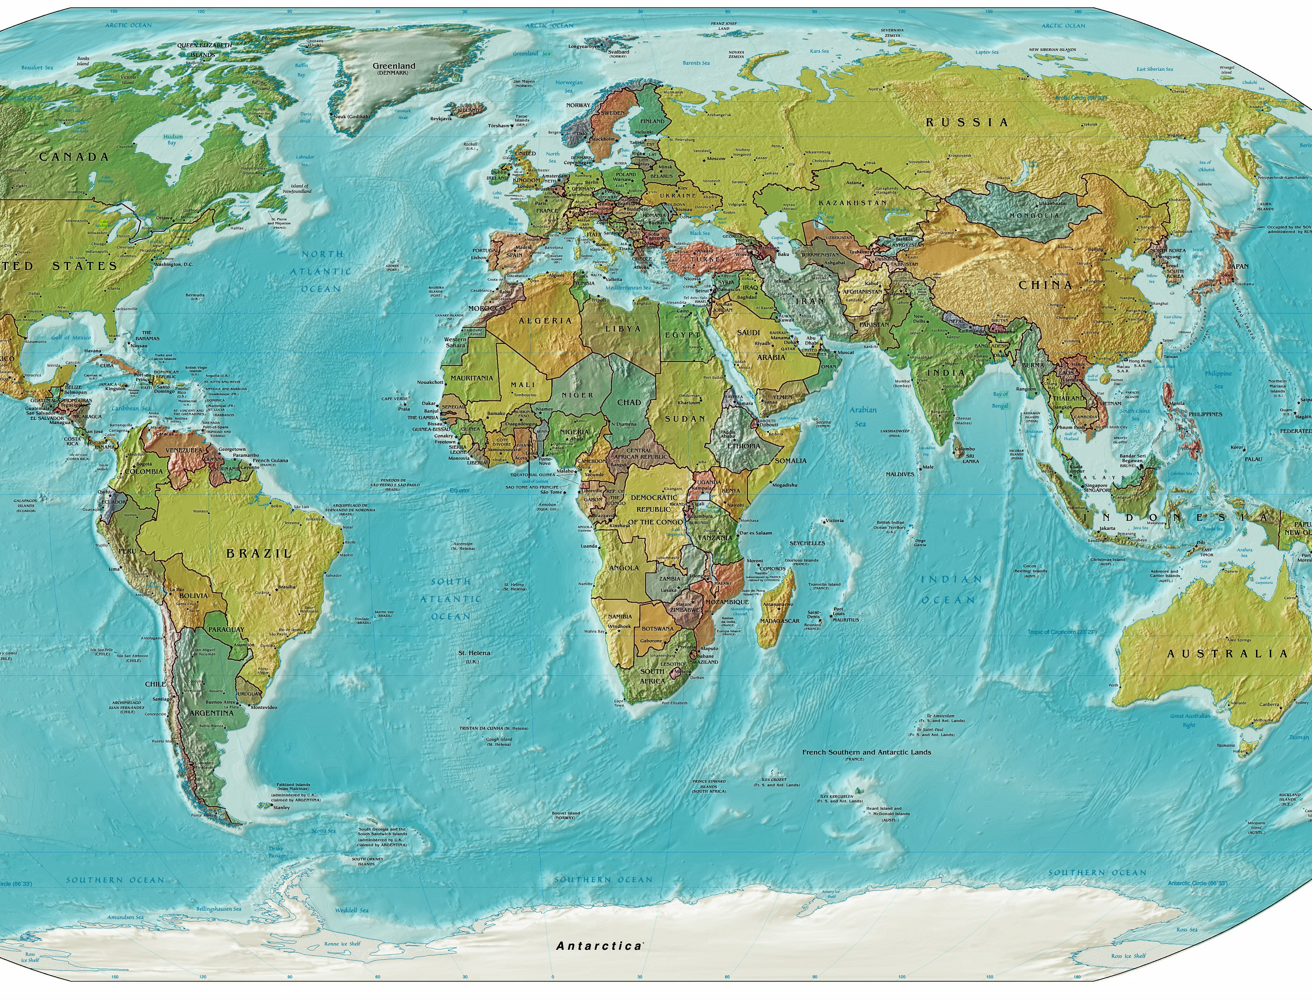
maps
Visual of where things are in the world

Slide 14
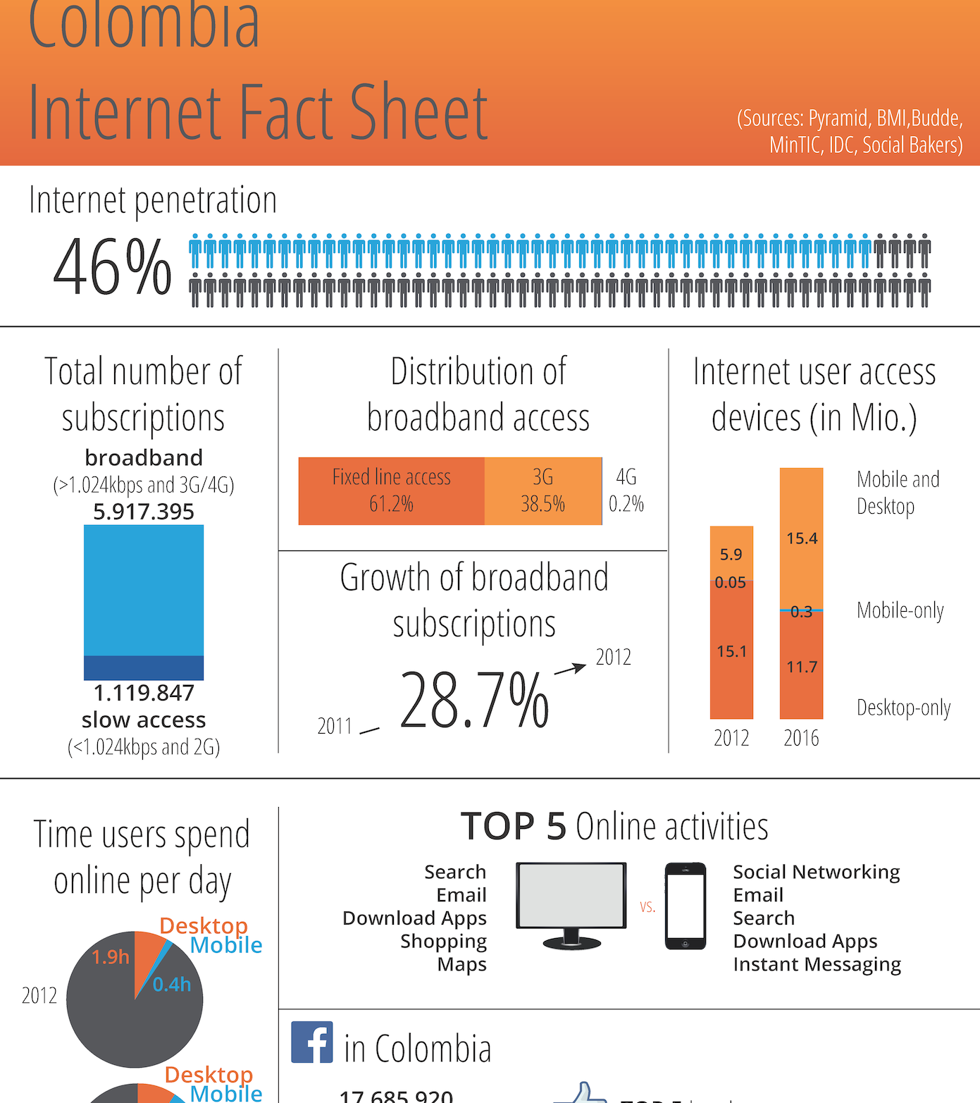
facts
Pizza is on the lunch menu
Mrs. Murray’s room is 202
Mrs. Murray is 44 years old
The desk is brown
The bell rings at 8:10 AM
Information that is certain and can be proven

Slide 15
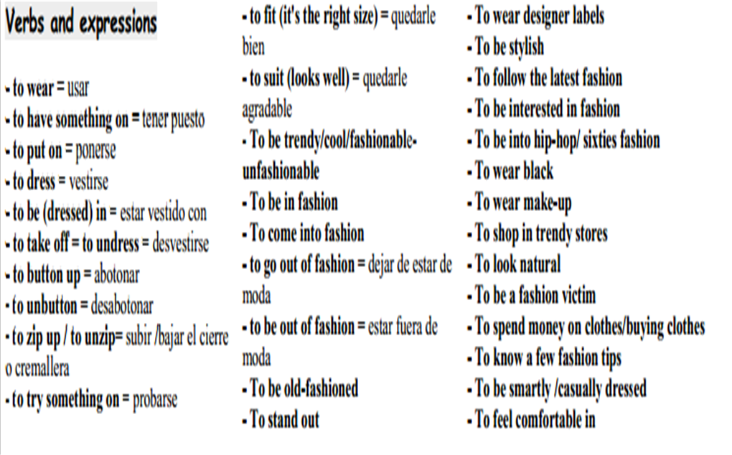
vocabulary
This Photo by Unknown Author is licensed under CC BY-SA-NC
Words that need to be known to understand the text

Slide 16
Types of print
Shows importance; stands out from other text
Examples:
Bold
Colored
italics

Slide 17
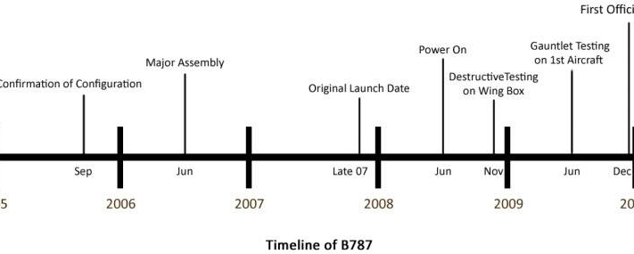
Time-line
Sequence of events in order of time

Slide 18
Bulleted list
Emphasizes key points/concepts

Slide 19
illustration
Drawn by hand
Shows what something looks like

