Slide 1
Conjunctions
Compound Subject and predicate

Slide 2
Coordination Conjunction definition:
A conjunction is placed between words, phrases, clauses, or sentences of equal rank to join them.
FANBOYS!
For
And
No
But
Or
Yet
So

Slide 3
Subordinate Conjunction definition
a conjunction that introduces a subordinate clause
(some are often called transition words)

Slide 4
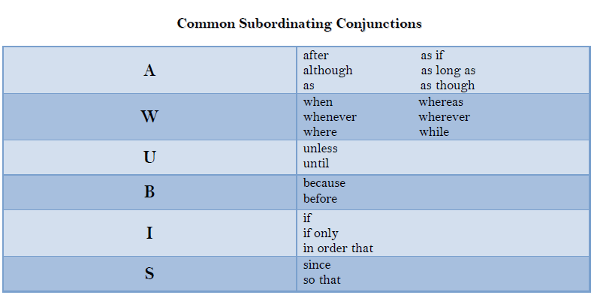

Slide 5
Compound sentence Definition:
A sentence including two or more independent clauses combined with a conjunction or semicolon.
Example: Sue learned French in school, but her friend learned it online.
Example: Cake is my favorite dessert; pancakes are my favorite breakfast.

Slide 6
Compound subject definition:
Two or more simple subjects joined by a conjunction are sharing the same predicate.
Example: Amy and Jenny like cake.

Slide 7
Compound predicate definition:
One simple subject performs two or more simple predicates that are joined by a conjunction.
Example: Belinda shops and eats with her grandma.

