Slide 1
Virtual Library Card: Schools & Public Libraries Partnership
Tammy Turgeon, Director

Slide 2
UCS Process
Notification to Parents
Schools assigned a public library
Clinton-Macomb Public Library
Shelby Township Library
Sterling Heights Public Library
Utica Public Library
Access beyond Virtual Library Card

Slide 3
Overview of Resources
Overdrive (ebooks and eaudio books)
tutor.com (online tutoring and test prep)
Freegal (digital music)
RBDigital (digital magazines)

Slide 4
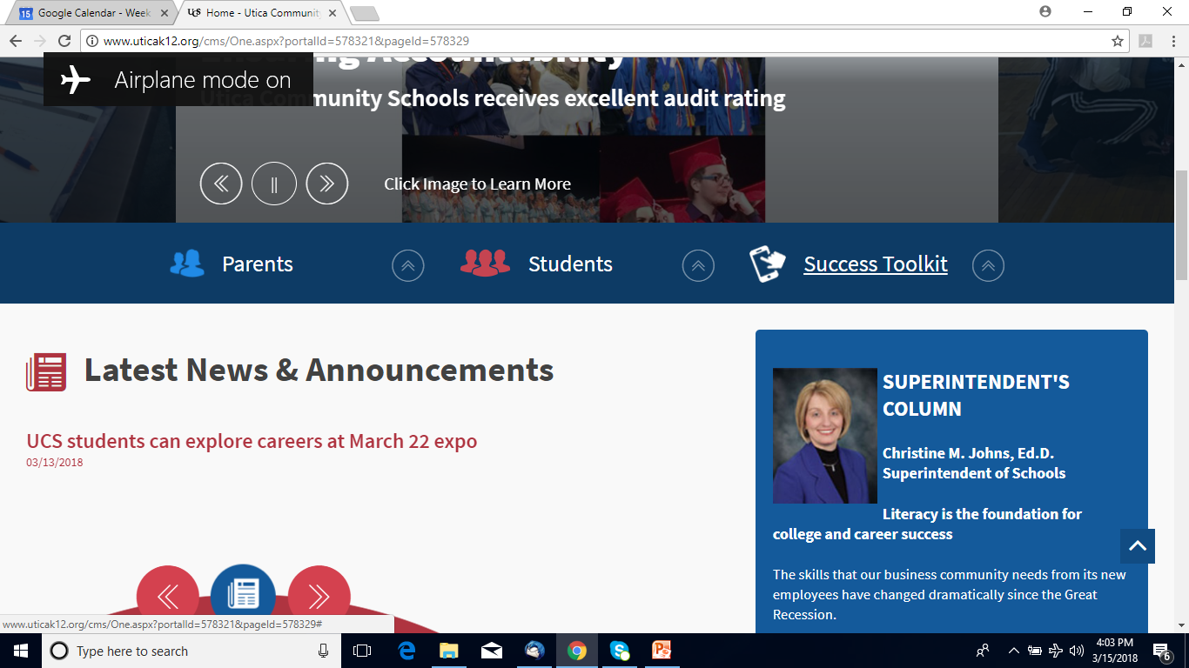
Overview of Resources

Slide 5
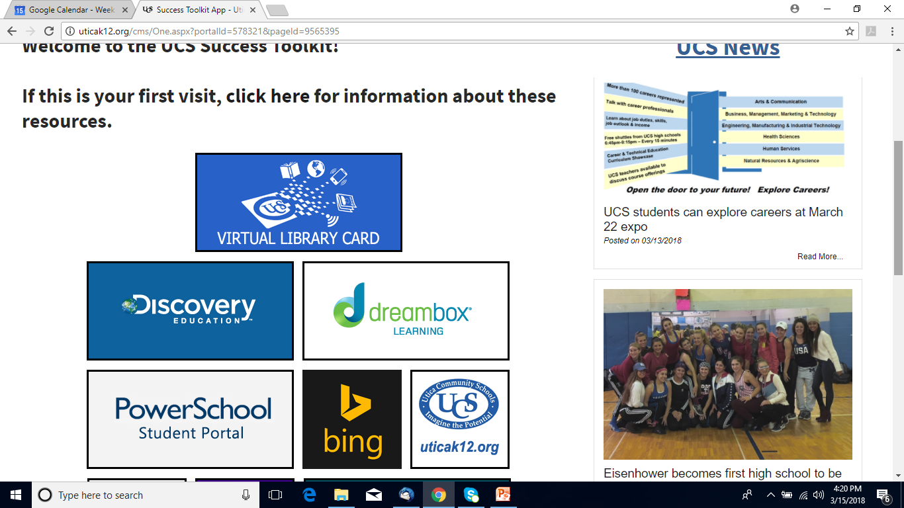
Overview of Resources

Slide 6
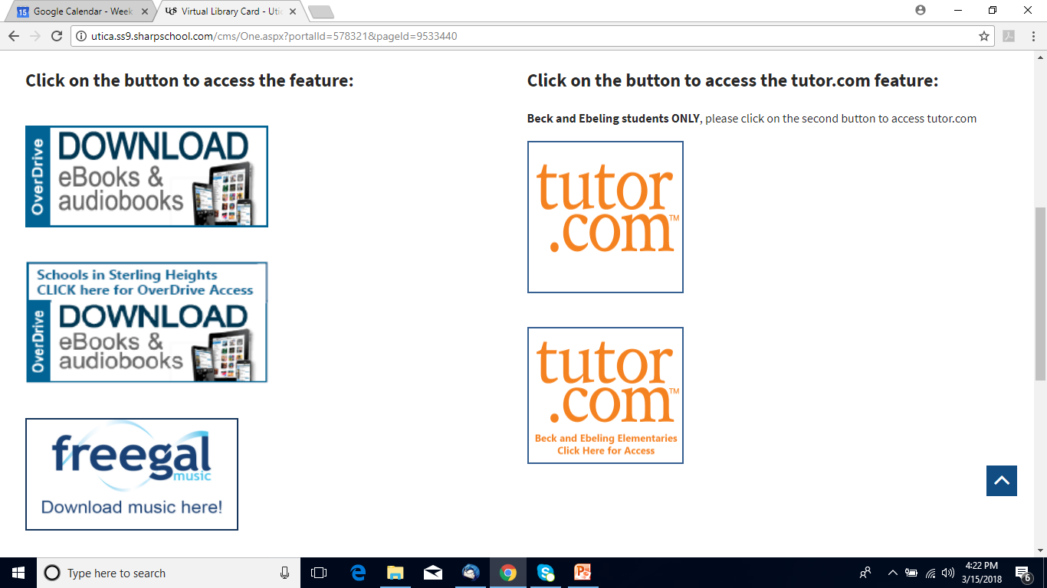
Overview of Resources

Slide 7
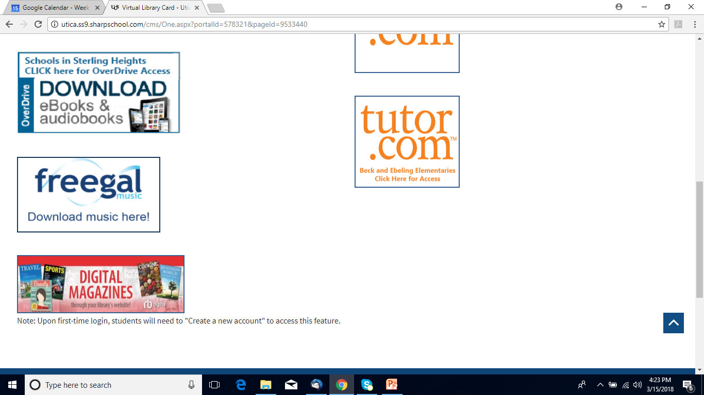
Overview of Resources

Slide 8
Overdrive
Check out books just like print books – place holds, check out for 21 days
Access to ebooks and eaudiobooks
Youth, Teen and Adult titles available
https://mlc.overdrive.com/

Slide 9
tutor.com
Combines on-demand, real-time tutoring with several self-study tools to create a robust, personalized learning experience
Live Tutors available from 4 – 11 p.m. everyday
The Princeton Review’s SAT/ACT Essentials Test Prep is included and available 24/7
Includes other services: Drop off review, practice quizzes, and study resources
www.tutor.com/suburban
https://www.youtube.com/embed/LzArJoT-fdM

Slide 10
Freegal
Freegal offers access to about 13 million songs, including Sony Music’s catalog of legendary artists, and over 40,000 music videos.
You can download up to 5 songs a week and stream up to 3 hours of music a day.
Freegal app
https://libcoopmi.freegalmusic.com/homes/index

Slide 11
RBDigital
136 magazines (looking at adding some International Language titles)
Always available, no returns
Can receive email reminders when a new issue of a magazine you like is published
RBDigital app
https://www.rbdigital.com/suburbancoopmi/service/magazines/landing

Slide 12
Your Public Libraries
Clinton-Macomb Public Library
www.cmpl.org
Shelby Township Library
www.shelbytwplib.org
Sterling Heights Public Library
www.shpl.net
Utica Public Library
www.uticalibrary.com

Slide 13
Questions?
Thank You and We Look Forward to Working More With UCS

